Slide 1
Applications of Stack
Numerous applications:
Parsing code:
Matching parenthesis
XML (e.g., XHTML)
Tracking function calls
Dealing with undo/redo operations
Reverse-Polish calculators

Slide 2
Infix Notation
To add A, B, we write
A+B
To multiply A, B, we write
A*B
The operators ('+' and '*') go in between the operands ('A' and 'B')
This is "Infix" notation.

Slide 3
Prefix Notation
Instead of saying "A plus B", we could say "add A,B " and write
+ A B
"Multiply A,B" would be written
* A B
This is Prefix notation.

Slide 4
Postfix Notation
Another alternative is to put the operators after the operands as in
A B +
and
A B *
This is Postfix notation.
Notes:
"A,B are multiplied"
"A,B are added"

Slide 5
Infix, Prefix and Postfix
The terms infix, prefix, and postfix tell us whether the operators go between, before, or after the operands.
Pre A In B Post

Slide 6
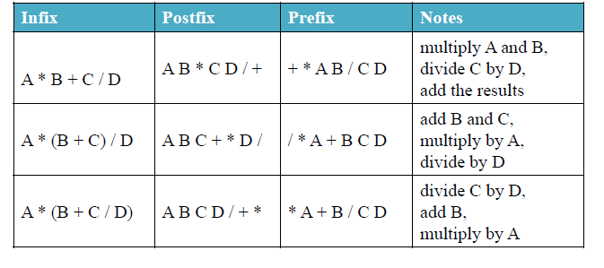
Arithmetics Expression Evaluation

Slide 7
Reverse-Polish Notation
Normally, mathematics is written using what we call in-fix notation:
(3 + 4) × 5 – 6
The operator is placed between to operands
One weakness: parentheses are required
(3 + 4) × 5 – 6 = 29
3 + 4 × 5 – 6 = 17
3 + 4 × (5 – 6) = –1
(3 + 4) × (5 – 6) = –7

Slide 8
Parentheses
Evaluate 2+3*5.
+ First:
(2+3)*5 = 5*5 = 25
* First:
2+(3*5) = 2+15 = 17
Infix notation requires Parentheses.

Slide 9
What about Prefix Notation?
+ 2 * 3 5 =
= + 2 * 3 5
= + 2 15 = 17
* + 2 3 5 =
= * + 2 3 5
= * 5 5 = 25
No parentheses needed!

Slide 10
Postfix Notation
2 3 5 * + =
= 2 3 5 * +
= 2 15 + = 17
2 3 + 5 * =
= 2 3 + 5 *
= 5 5 * = 25
No parentheses needed here either!

Slide 11
Conclusion:
Infix is the only notation that requires parentheses in order to change the order in which the operations are done.

Slide 12
Fully Parenthesized Expression
A FPE has exactly one set of Parentheses enclosing each operator and its operands.
Which is fully parenthesized?
( A + B ) * C
( ( A + B) * C )
( ( A + B) * ( C ) )

Slide 13
Reverse-Polish Notation
When we place the operands first, followed by the operator:
(3 + 4) × 5 – 6
3 4 + 5 × 6 –
Parsing reads left-to-right and performs any operation on the last two operands:
3 4 + 5 × 6 –
7 5 × 6 –
35 6 –
29

Slide 14
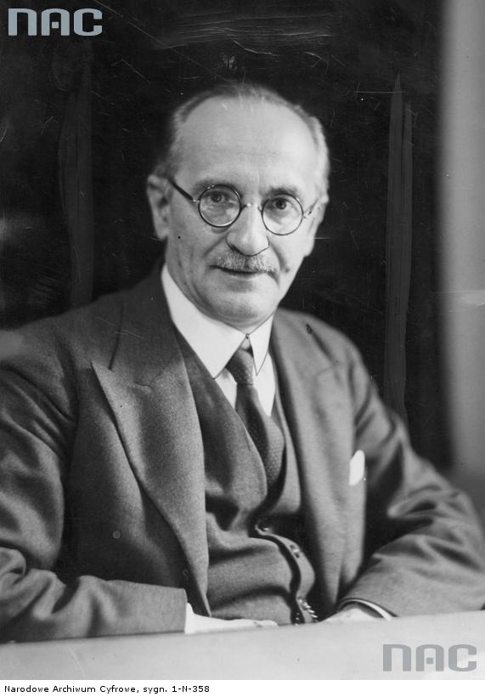
Reverse-Polish Notation
This is called reverse-Polish notation after the mathematician Jan Łukasiewicz
this forms the basis of the recursive stack used on all processors
He also made significant contributions to logic and other fields
http://www.audiovis.nac.gov.pl/
http://xkcd.com/645/

Slide 15
Reverse-Polish Notation
Benefits:
No ambiguity and no brackets are required
It is the same process used by a computer to perform computations:
operands must be loaded into registers before operations can be performed on them
Reverse-Polish can be processed using stacks

Slide 16
Infix to Prefix Conversion
Move each operator to the left of its operands & remove the parentheses:
( ( A + B) * ( C + D ) )
Notes:
Start with Fully parenthesized expression. Move each operator to the left of its operands and remove the set of parentheses.

Slide 17
Infix to Prefix Conversion
Move each operator to the left of its operands & remove the parentheses:
( + A B * ( C + D ) )
Notes:
Start with Fully parenthesized expression. Move each operator to the left of its operands and remove the set of parentheses.

Slide 18
Infix to Prefix Conversion
Move each operator to the left of its operands & remove the parentheses:
* + A B ( C + D )
Notes:
Start with Fully parenthesized expression. Move each operator to the left of its operands and remove the set of parentheses.

Slide 19
Infix to Prefix Conversion
Move each operator to the left of its operands & remove the parentheses:
* + A B + C D
Order of operands does not change!
Notes:
Start with Fully parenthesized expression. Move each operator to the left of its operands and remove the set of parentheses.

Slide 20
Infix to Postfix
( ( ( A + B ) * C ) - ( ( D + E ) / F ) )
A B + C * D E + F / -
Operand order does not change!
Operators are in order of evaluation!

Slide 21
Computer Algorithm FPE Infix To Postfix
Assumptions:
Space delimited list of tokens represents a FPE infix expression
Operands are single characters.
Operators +,-,*,/

Slide 22
FPE Infix To Postfix
Initialize a Stack for operators, output list
Split the input into a list of tokens.
for each token (left to right):
if it is operand: append to output
if it is '(': push onto Stack
if it is ')': pop & append till '('

Slide 23
Infix to Postfix
Initialize a Stack for operators, output list
Split the input into a list of tokens.
for each token (left to right):
if it is operand: append to output
if it is '(': push onto Stack
if it is ')': pop & append till '('
if it is '+-*/':
while peek has precedence ≥ it:
pop & append
push onto Stack
pop and append the rest of the Stack.

Slide 24
Create an empty stack for keeping operators. Create an empty list for output.
Split the input into a list of tokens.
Scan the token list from left to right.
If the token is an operand, append it to the end of the output list.
If the token is a left parenthesis, push it on the opstack.
If the token is a right parenthesis, pop the opstack until the corresponding left parenthesis is removed. Append each operator to the end of the output list.
If the token is an operator, *, /, +, or -, push it on the opstack. However, first remove any operators already on the opstack that have higher or equal precedence and append them to the output list.
When the input expression has been completely processed, check the opstack. Any operators still on the stack can be removed and appended to the end of the output list.

Slide 25
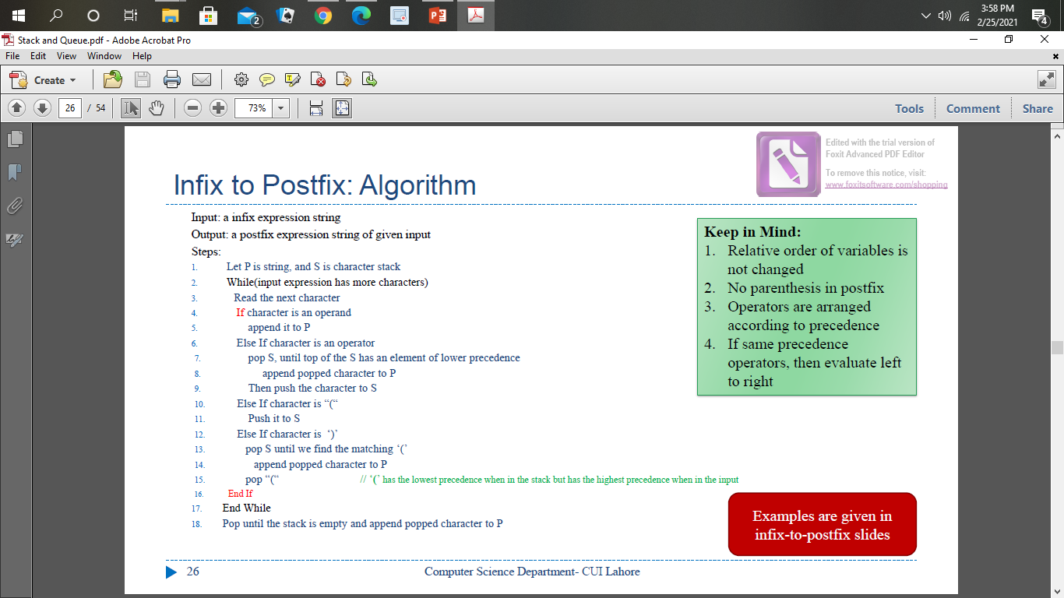
Infix to Postfix Algorithm

Slide 26
FPE Infix to Postfix
( ( ( A + B ) * ( C - E ) ) / ( F + G ) )
stack: <empty>
output: []

Slide 27
FPE Infix to Postfix
( ( A + B ) * ( C - E ) ) / ( F + G ) )
stack: (
output: []

Slide 28
FPE Infix to Postfix
( A + B ) * ( C - E ) ) / ( F + G ) )
stack: ( (
output: []

Slide 29
FPE Infix to Postfix
A + B ) * ( C - E ) ) / ( F + G ) )
stack: ( ( (
output: []

Slide 30
FPE Infix to Postfix
+ B ) * ( C - E ) ) / ( F + G ) )
stack: ( ( (
output: [A]

Slide 31
FPE Infix to Postfix
B ) * ( C - E ) ) / ( F + G ) )
stack: ( ( ( +
output: [A]

Slide 32
FPE Infix to Postfix
) * ( C - E ) ) / ( F + G ) )
stack: ( ( ( +
output: [A B]

Slide 33
FPE Infix to Postfix
* ( C - E ) ) / ( F + G ) )
stack: ( (
output: [A B + ]

Slide 34
FPE Infix to Postfix
( C - E ) ) / ( F + G ) )
stack: ( ( *
output: [A B + ]

Slide 35
FPE Infix to Postfix
C - E ) ) / ( F + G ) )
stack: ( ( * (
output: [A B + ]

Slide 36
FPE Infix to Postfix
- E ) ) / ( F + G ) )
stack: ( ( * (
output: [A B + C ]

Slide 37
FPE Infix to Postfix
E ) ) / ( F + G ) )
stack: ( ( * ( -
output: [A B + C ]

Slide 38
FPE Infix to Postfix
) ) / ( F + G ) )
stack: ( ( * ( -
output: [A B + C E ]

Slide 39
FPE Infix to Postfix
) / ( F + G ) )
stack: ( ( *
output: [A B + C E - ]

Slide 40
FPE Infix to Postfix
/ ( F + G ) )
stack: (
output: [A B + C E - * ]

Slide 41
FPE Infix to Postfix
( F + G ) )
stack: ( /
output: [A B + C E - * ]

Slide 42
FPE Infix to Postfix
F + G ) )
stack: ( / (
output: [A B + C E - * ]

Slide 43
FPE Infix to Postfix
+ G ) )
stack: ( / (
output: [A B + C E - * F ]

Slide 44
FPE Infix to Postfix
G ) )
stack: ( / ( +
output: [A B + C E - * F ]

Slide 45
FPE Infix to Postfix
) )
stack: ( / ( +
output: [A B + C E - * F G ]

Slide 46
FPE Infix to Postfix
)
stack: ( /
output: [A B + C E - * F G + ]

Slide 47
FPE Infix to Postfix
stack: <empty>
output: [A B + C E - * F G + / ]

Slide 48
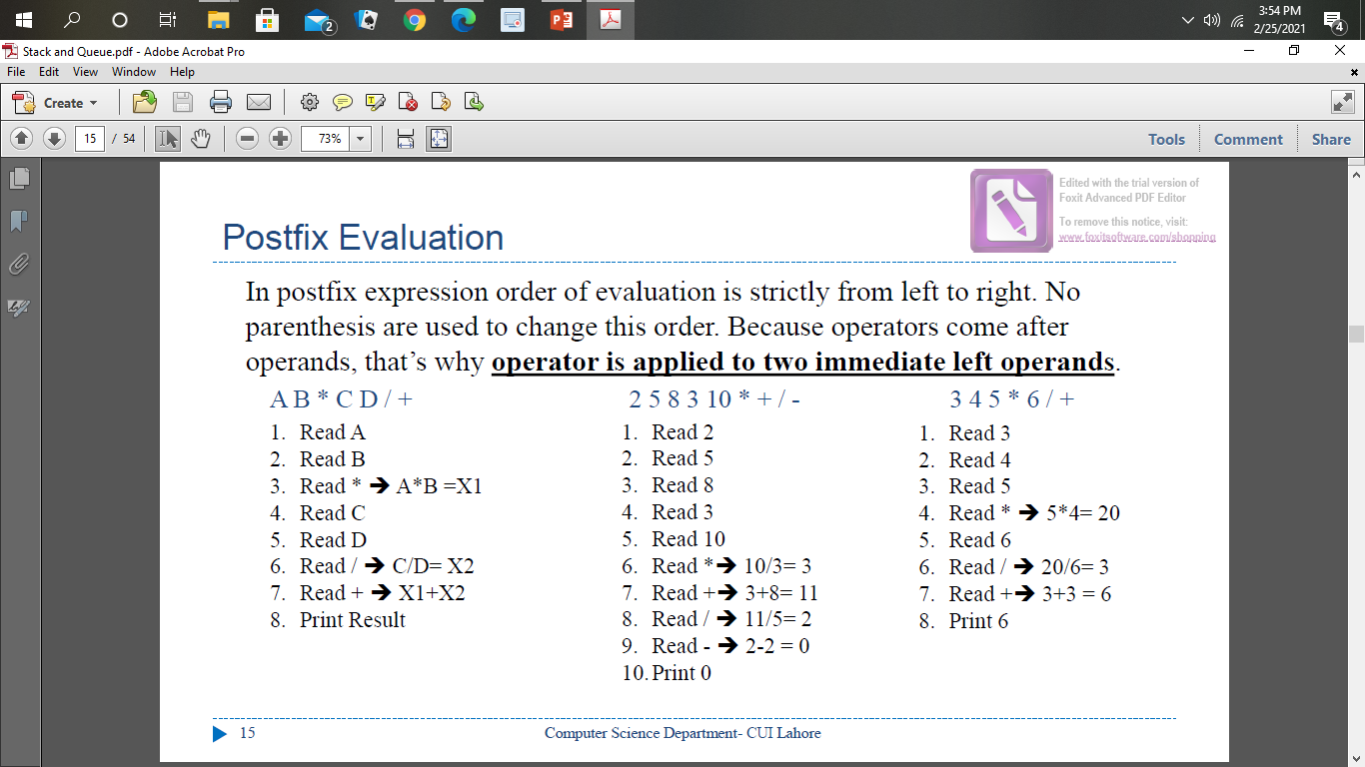
Postfix evaluation

Slide 49
Problem with FPE
Too many parentheses.
Establish precedence rules:
We can alter the previous program to use the precedence rules.

Slide 50
Reverse-Polish Notation
The easiest way to parse reverse-Polish notation is to use an operand stack:
operands are processed by pushing them onto the stack
when processing an operator:
pop the last two items off the operand stack,
perform the operation, and
push the result back onto the stack

Slide 51
Reverse-Polish Notation
Evaluate the following reverse-Polish expression using a stack:
1 2 3 + 4 5 6 × – 7 × + – 8 9 × +

Slide 52
Reverse-Polish Notation
Push 1 onto the stack
1 2 3 + 4 5 6 × – 7 × + – 8 9 × +
1

Slide 53
Reverse-Polish Notation
Push 1 onto the stack
1 2 3 + 4 5 6 × – 7 × + – 8 9 × +
2
1

Slide 54
Reverse-Polish Notation
Push 3 onto the stack
1 2 3 + 4 5 6 × – 7 × + – 8 9 × +
3
2
1

Slide 55
Reverse-Polish Notation
Pop 3 and 2 and push 2 + 3 = 5
1 2 3 + 4 5 6 × – 7 × + – 8 9 × +
5
1

Slide 56
Reverse-Polish Notation
Push 4 onto the stack
1 2 3 + 4 5 6 × – 7 × + – 8 9 × +
4
5
1

Slide 57
Reverse-Polish Notation
Push 5 onto the stack
1 2 3 + 4 5 6 × – 7 × + – 8 9 × +
5
4
5
1

Slide 58
Reverse-Polish Notation
Push 6 onto the stack
1 2 3 + 4 5 6 × – 7 × + – 8 9 × +
6
5
4
5
1

Slide 59
Reverse-Polish Notation
Pop 6 and 5 and push 5 × 6 = 30
1 2 3 + 4 5 6 × – 7 × + – 8 9 × +
30
4
5
1

Slide 60
Reverse-Polish Notation
Pop 30 and 4 and push 4 – 30 = –26
1 2 3 + 4 5 6 × – 7 × + – 8 9 × +
–26
5
1

Slide 61
Reverse-Polish Notation
Push 7 onto the stack
1 2 3 + 4 5 6 × – 7 × + – 8 9 × +
7
–26
5
1

Slide 62
Reverse-Polish Notation
Pop 7 and –26 and push –26 × 7 = –182
1 2 3 + 4 5 6 × – 7 × + – 8 9 × +
–182
5
1

Slide 63
Reverse-Polish Notation
Pop –182 and 5 and push –182 + 5 = –177
1 2 3 + 4 5 6 × – 7 × + – 8 9 × +
–177
1

Slide 64
Reverse-Polish Notation
Pop –177 and 1 and push 1 – (–177) = 178
1 2 3 + 4 5 6 × – 7 × + – 8 9 × +
178

Slide 65
Reverse-Polish Notation
Push 8 onto the stack
1 2 3 + 4 5 6 × – 7 × + – 8 9 × +
8
178

Slide 66
Reverse-Polish Notation
Push 1 onto the stack
1 2 3 + 4 5 6 × – 7 × + – 8 9 × +
9
8
178

Slide 67
Reverse-Polish Notation
Pop 9 and 8 and push 8 × 9 = 72
1 2 3 + 4 5 6 × – 7 × + – 8 9 × +
72
178

Slide 68
Reverse-Polish Notation
Pop 72 and 178 and push 178 + 72 = 250
1 2 3 + 4 5 6 × – 7 × + – 8 9 × +
250

Slide 69
Reverse-Polish Notation
Thus
1 2 3 + 4 5 6 × – 7 × + – 8 9 × +
evaluates to the value on the top: 250
The equivalent in-fix notation is
((1 – ((2 + 3) + ((4 – (5 × 6)) × 7))) + (8 × 9))
We reduce the parentheses using order-of-operations:
1 – (2 + 3 + (4 – 5 × 6) × 7) + 8 × 9

Slide 70
Reverse-Polish Notation
Incidentally,
1 – 2 + 3 + 4 – 5 × 6 × 7 + 8 × 9 = – 132
which has the reverse-Polish notation of
1 2 – 3 + 4 + 5 6 7 × × – 8 9 × +
For comparison, the calculated expression was
1 2 3 + 4 5 6 × – 7 × + – 8 9 × +

Slide 71
The Queue ADT
Like stacks, queues are lists.
With a queue, however, insertion is done at one end, whereas deletion is performed at the other end.
The basic operations on a queue are Enqueue, which inserts an element at the end of the list (called the rear), and Dequeue, which deletes (and returns) the element at the start of the list (known as the front).
FIFO: First in, First Out

Slide 72
Array Implementation of Queues
For each queue data structure, we keep an array, Queue[], and the positions Front and Rear, which represent the ends of the queue.
We also keep track of the number of elements that are actually in the queue, Size. All this information is part of one structure.
The following figure shows a queue in some intermediate state. The cells that are blanks have undefined values in them:
5
2
7
1
Front
Rear

Slide 73
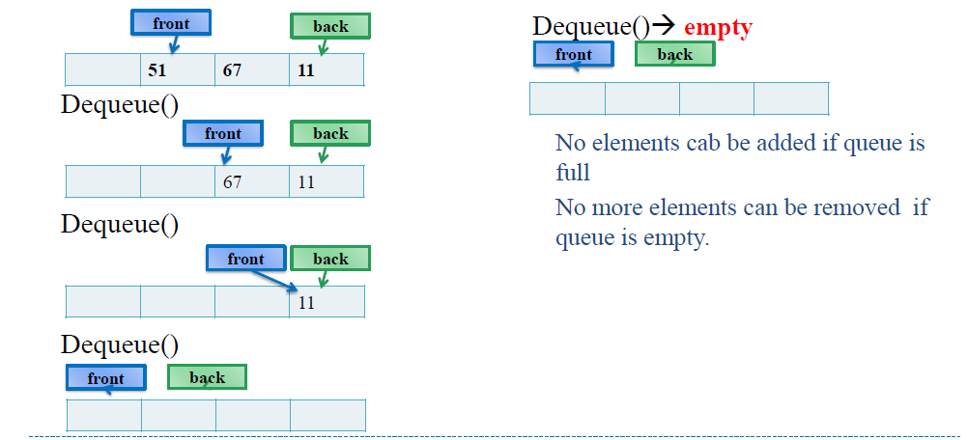
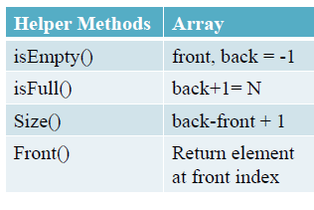
How Queue Works?

Slide 74
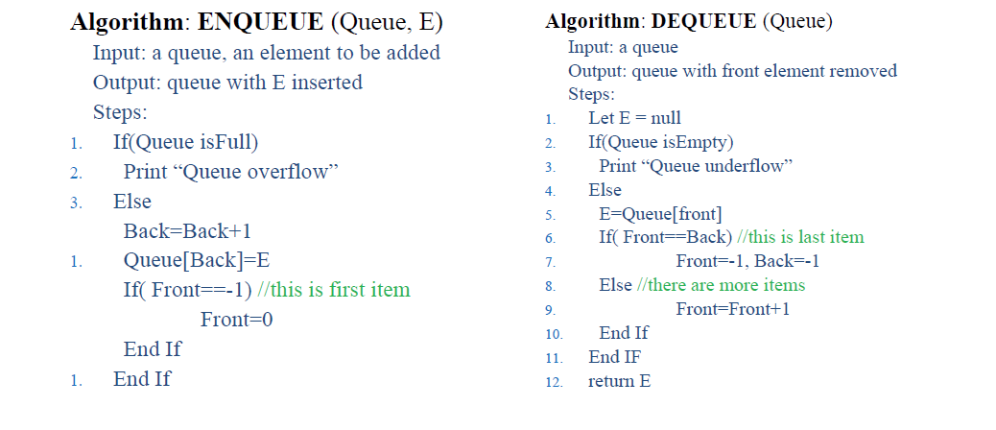
Algorithm (array based)

Slide 75
Array Implementation of Queues
To Enqueue an element X, we increment Size and Rear, then set Queue[Rear]=X.
To Dequeue an element, we set the return value to Queue[Front], decrement Size, and then increment Front.
Whenever Front or Rear gets to the end of the array, it is wrapped around to the beginning. This is known as a circular array implementation.

Slide 76
Circular Queues
The simple array implementation of queue has a problem
It is wasting space
Because front is moving towards back and leaving empty space behind.
Elements are stored towards end of array and front cells may be empty due to dequeue
To resolve this problem array can be used as a circular array.
When we reached at end of array, start from beginning
Whenever Front or Rear gets to the end of the array, it is wrapped around to the beginning. This is known as a circular array implementation.

Slide 77
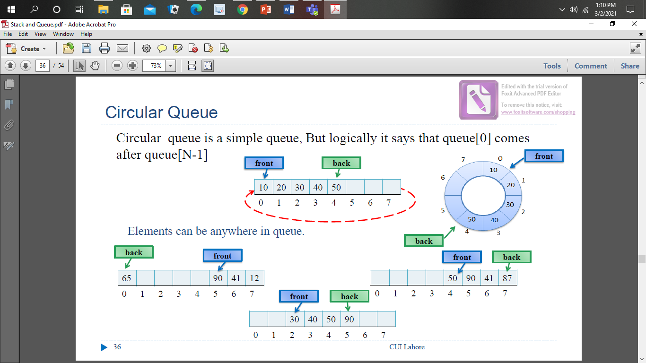
Circular Queue

Slide 78
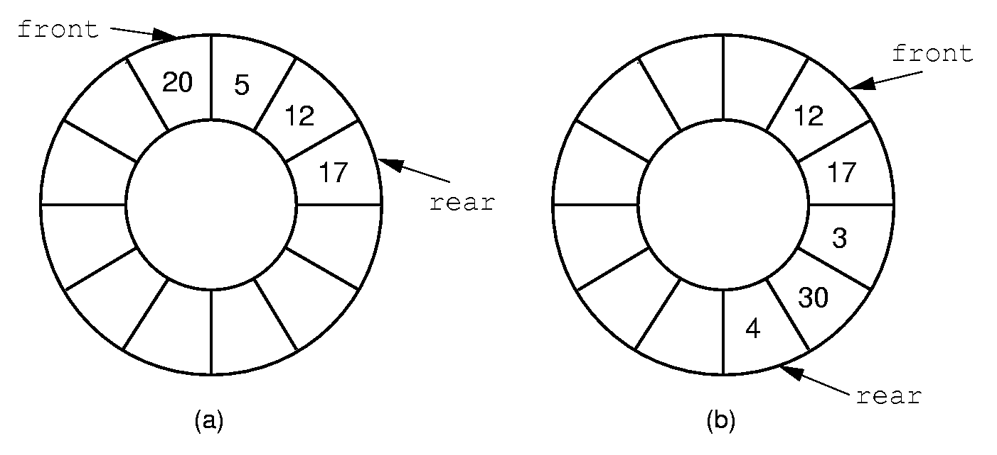
Queue Implementation (2)
Notes:
By using the mod function, we can easily achieve the effect of a “circular” queue.
This leaves one more issue. Where do the front and rear pointers go (point to the item? Or to the space before/after the item)? And, how do we distinguish a full from an empty queue?
Given a fixed position for the front element (and its pointer), there are n-1 possible states for the queue (0 through n elements in the queue for an array of size n), but only n possible positions for rear. To solve this dilemma, we must either leave an empty slot in the queue, or use and external variable to determine if the queue is empty or not.

Slide 79
Circular Array Q Data Structure
Q
0
size - 1
enqueue(Object x) {
Q[back] = x ;
back = (back + 1) % size }
b
c
d
e
f
front
back
How test for empty list?
How to find K-th element in the queue?
What is complexity of these operations?
Limitations of this structure?
dequeue() {
x = Q[front] ;
front = (front + 1) % size;
return x ; }
Notes:
Here is a data structure implementation of the Q.
The queue is stored as an array, and, to avoid shifting all the elements each time an element is dequeued, we imagine that the array wraps around on itself.
This is an excellent example of how implementation can affect interface: notice the “is_full” function.
There’s also another problem here. What’s wrong with the Enqueue and Dequeue functions?
Your data structures should be robust! Make them robust before you even consider thinking about making them efficient! That is an order!

Slide 80
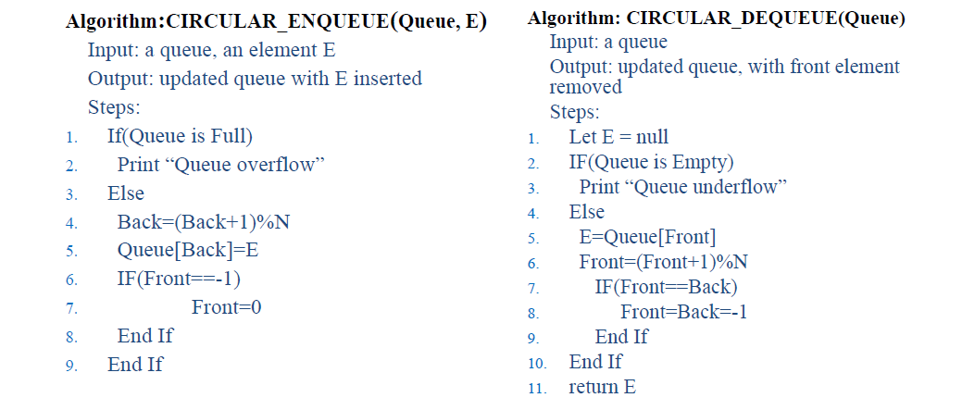
Algorithms

Slide 81
Helper Functions
Helper Methods | Queue | Circular Queue
isEmpty() | front, back = -1 | same
isFull() | back+1= N | (back+1)%N= front
Size() | back-front + 1 | (N-front+back)%N + 1 If front<back back-front + 1 Else (N-front) +(back+1)

Slide 82
Example Applications
When jobs are submitted to a printer, they are arranged in order of arrival.
Every real-life line is a queue. For instance, lines at ticket counters are queues, because service is first-come first-served.
A whole branch of mathematics, known as queueing theory, deals with computing, probabilistically, how long users expect to wait on a line, how long the line gets, and other such questions.

Slide 83
Priority Queue
Imagine a ticket window at Daewoo Terminal, the person who arrives first will get the ticket before the person who arrives later.
Now imagine process queue for CPU, ideally it should execute the process whose request was arrived first, but some time situation arise when a component/process raise request that is of highest priority and needs to be executed first regardless of the order of arriving in process queue, like computer shut down
That is the case where we need a queue which can handle priority.

Slide 84
Priority Queue
A priority queue is a collection of zero or more items, associated with each item is a priority.
In a normal queue the enqueue operation add an item at the back of the queue, and the dequeue operation removes an item at the front of the queue.
In priority queue, enqueue and dequeue operations consider the priorities of items to insert and remove them.
Priority queue does not follow "first in first out" order in general.
The highest priority can be either the most minimum value or most maximum
we will assume the highest priority is the minimum.

Slide 85
Priority Queue as ADT
Operations:
Enqueue(E)
Dequeue(): remove the item with the highest priority
Find() return the item with the highest priority
Examples
Process scheduling
Few processes have more priority
Job scheduling
N Jobs with limited resources to complete  Patients treatment in emergency

Slide 86
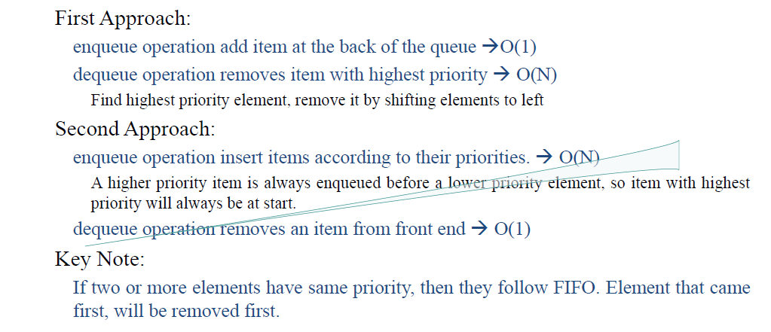
Priority Queue as ADT

Slide 87




First Approach
Enqueue(3)Enqueue(1) Enqueue(5) Enqueue(7) Enqueue(4) Enqueue(2)
Dequeue()
Find highest priority 2
Back=5
Back=3
3
1
5
7
4
2
3
5
7
4
Dequeue()
Find highest priority 1
}
Move to left
Back=4
Back=3
3
5
7
4
2
5
7
4

Slide 88
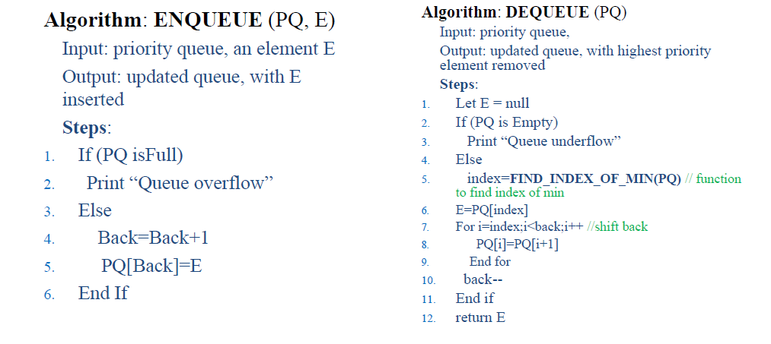
Algorithms

Slide 89
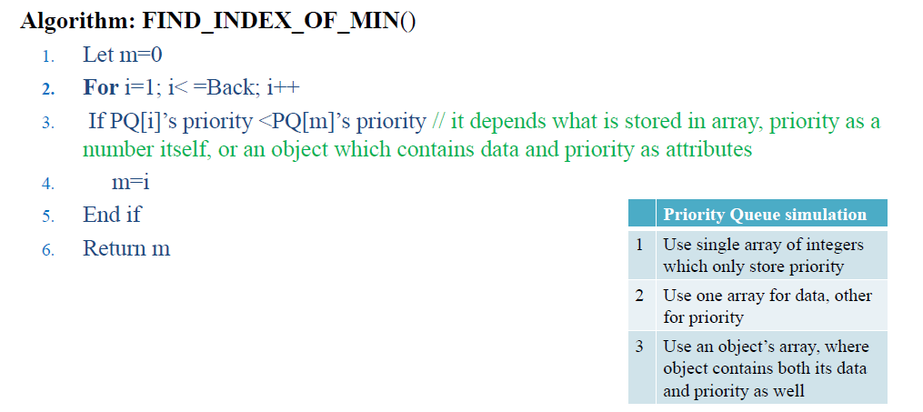
Algorithms

Slide 90
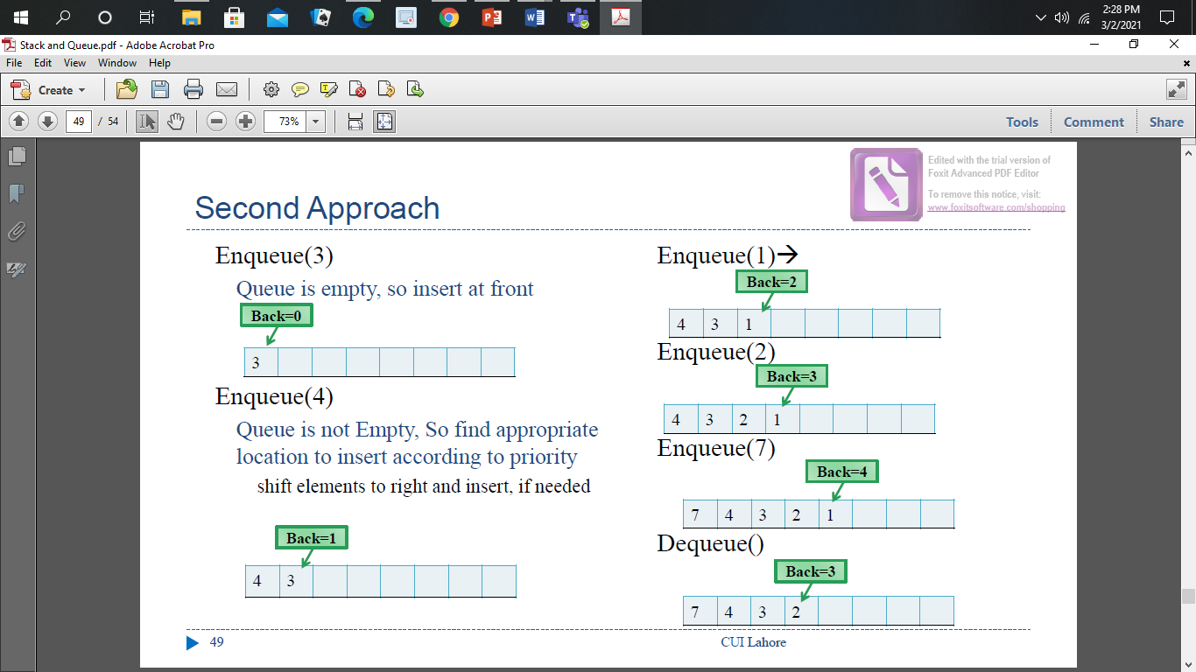
Second Approach

Slide 91
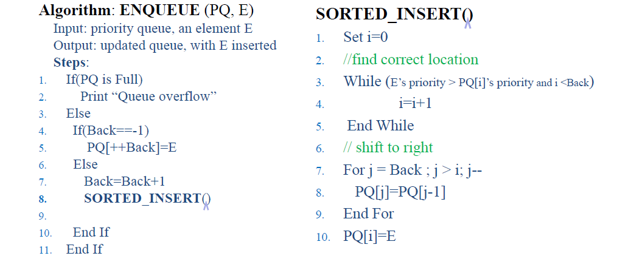
Algorithm

Slide 92
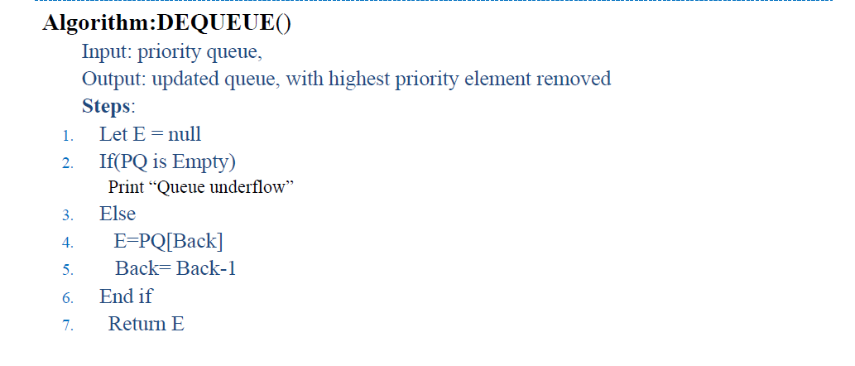
Algorithm

